Slide 1
Hawai’i Keiki- Asthma Strategies
Healthy Hawaiʻi Strategic Plan 2030 (HHSP) Summit
October 25th, 2023

Slide 2
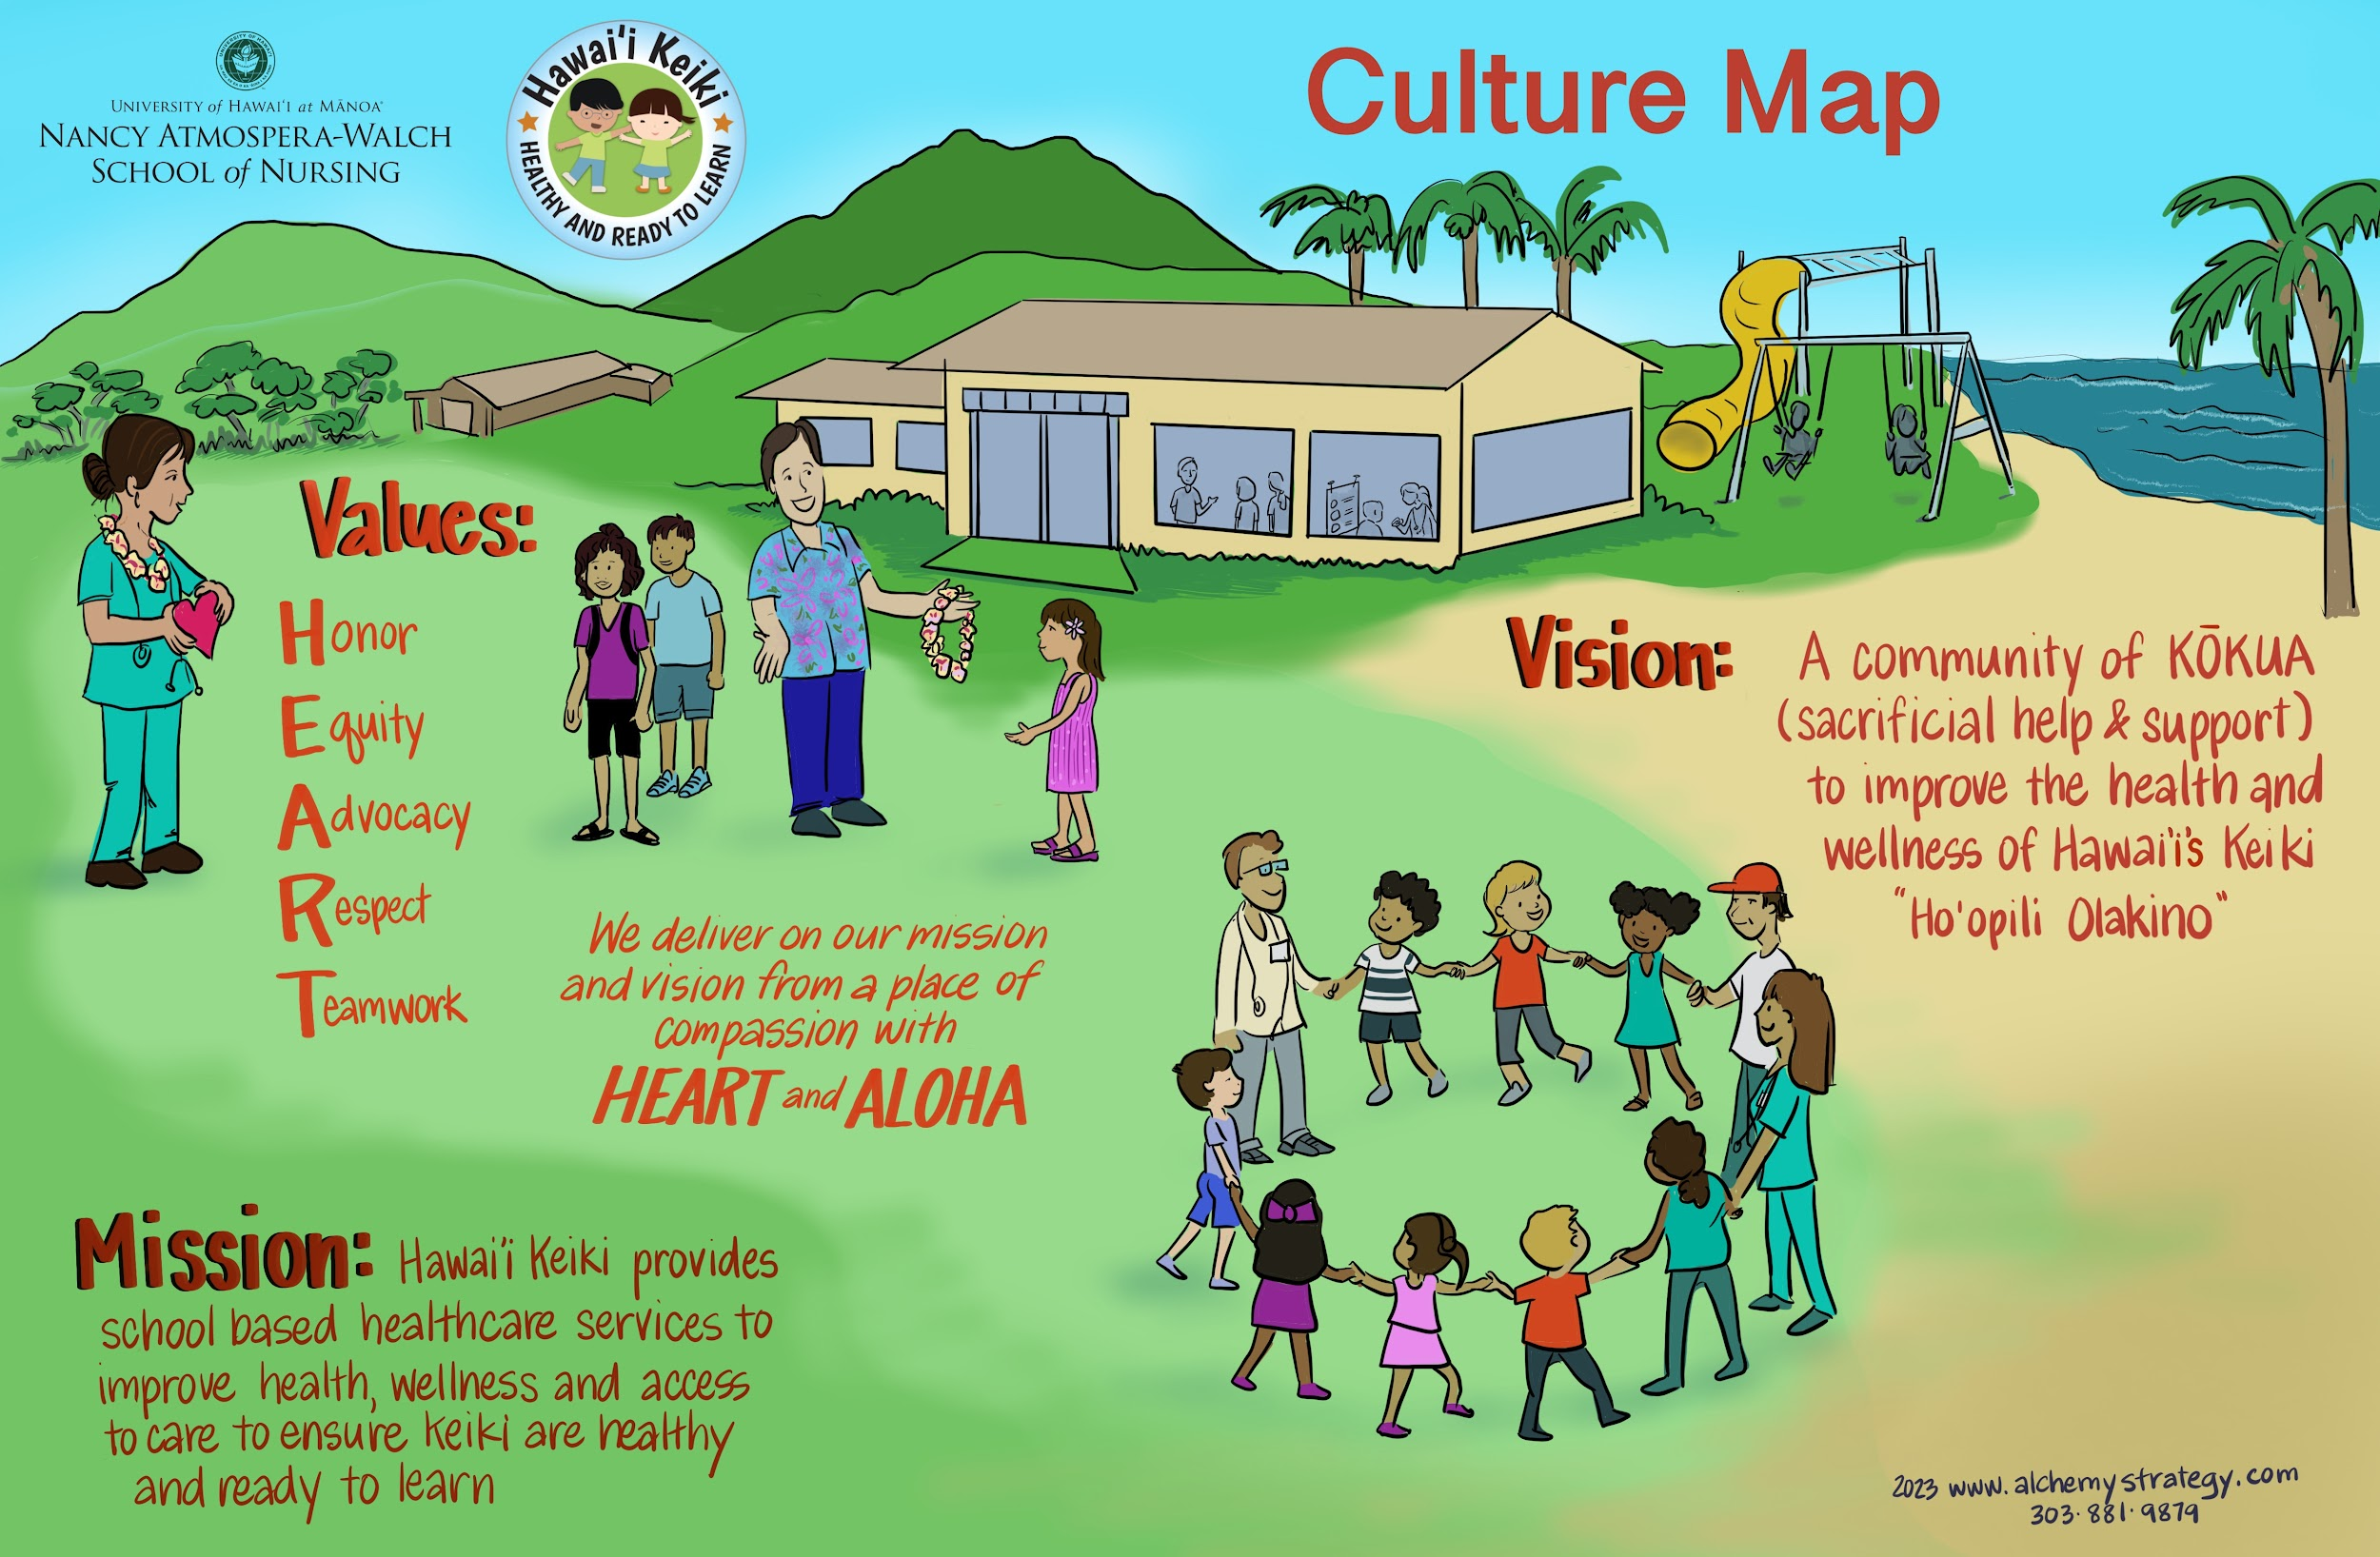
Objectives
Brief overview of Hawai’i Keiki
A review of our work in the
context of asthma prevention, education and treatment
A summary of our efforts with the Department of Health during the Spring 2022 Control Asthma Campaign
A look at how our efforts align with the HHSP in the education sector and barriers to implementation

Slide 3
Hawai’i Keiki
A partnership between the University of Hawaii at Manoa Nancy Atmospera Walch School of Nursing and the Hawaii Department of Education. The program is designed to improve access and quality of health services in the school by coordinating and expanding existing efforts of the partners and community resources.
Participate in care management for chronic conditions such as asthma, allergies and diabetes
Support the School Health Assistant
Assist with planning and implementing wellness events
Provide education and resources
Assess and manage acute events
Collect data and monitor trends

Slide 4
Hawai’i Keiki
Goal: To provide school-based health services through nurses and nurse practitioners to keep keiki healthy and ready to learn by providing access to school nursing services in Hawaii’s public schools.
2014–2019
2020
2022
Program grew from 4 nurses to 18
14 APRNs, 4 RNs
DOE received CARES funding to place a COVID Resource RN in each CA (33 total HK nurses); Health Hotline & Virtual Health Program
14 APRNs; 19 RNs
17 APRNs; 42 Complex RNs; >160 SHSS; 2 MH staff; 1 RDH
17 APRNs, 39 Complex RNs, 74 HT, 5 MH staff, 1 RDH
Expansion to 11 charter schools with 11 health technicians, 4 RNs, 1 APRN and 1 program manager
Initiated Oral Health Program
DOH-DOE MOA to expand HK for an RN in each Complex*; Mental Health Practitioner; Summer support
DOE: ESSER III funds to implement School Health Support Staff (SHSS) within HK to manage testing programs and extend HK impact
2019
2021
2023

Slide 5
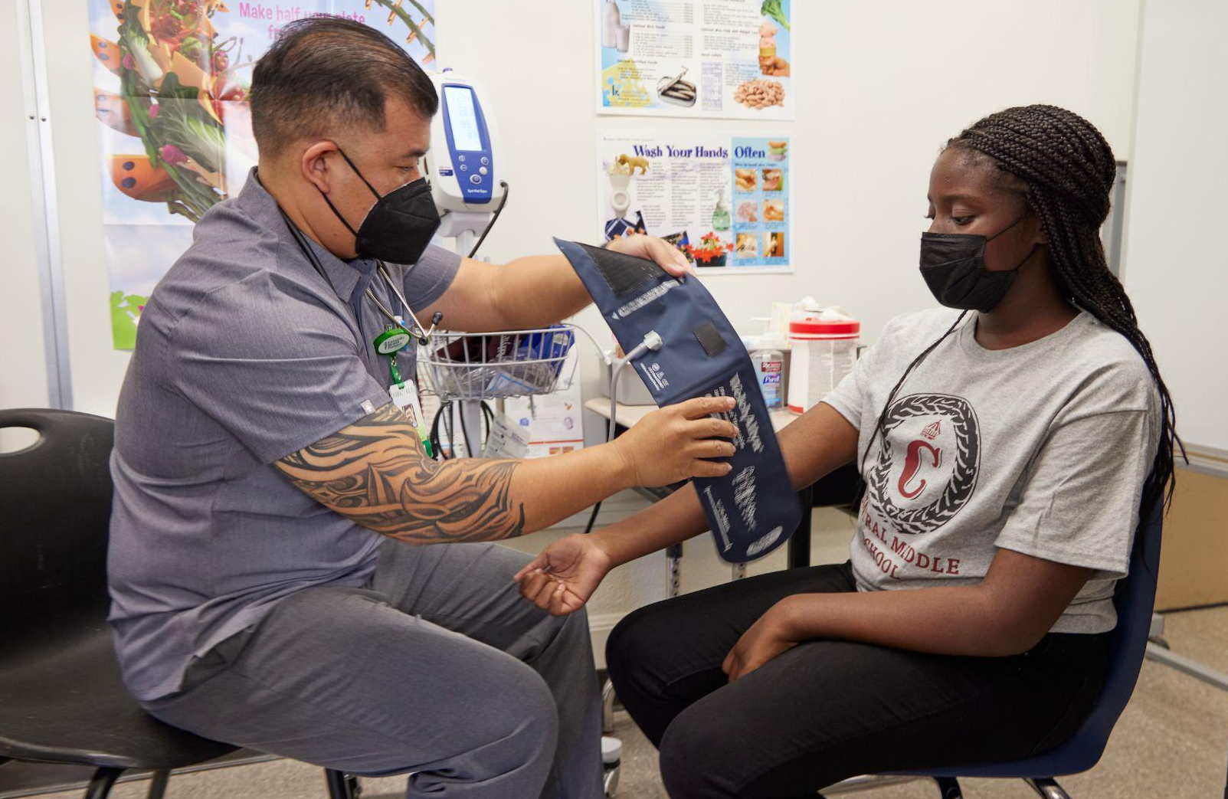
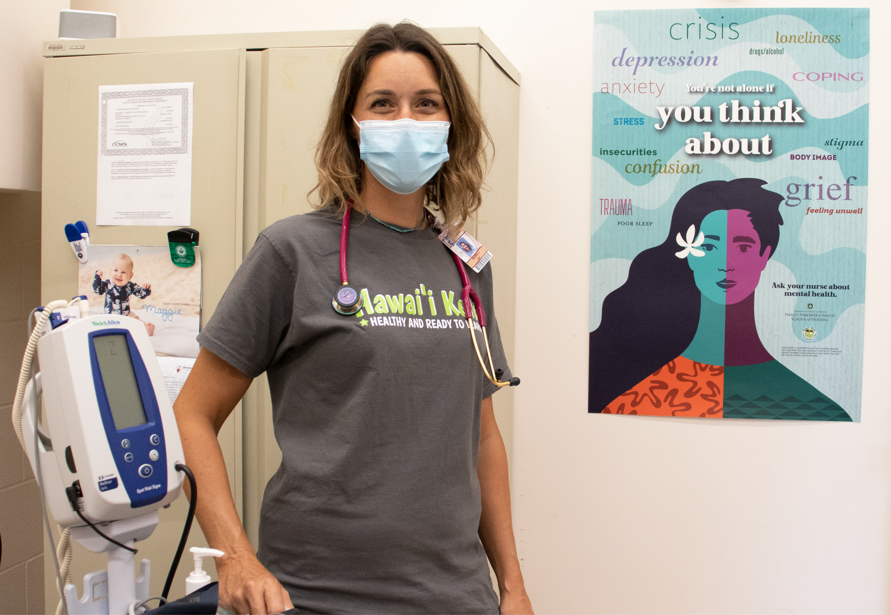
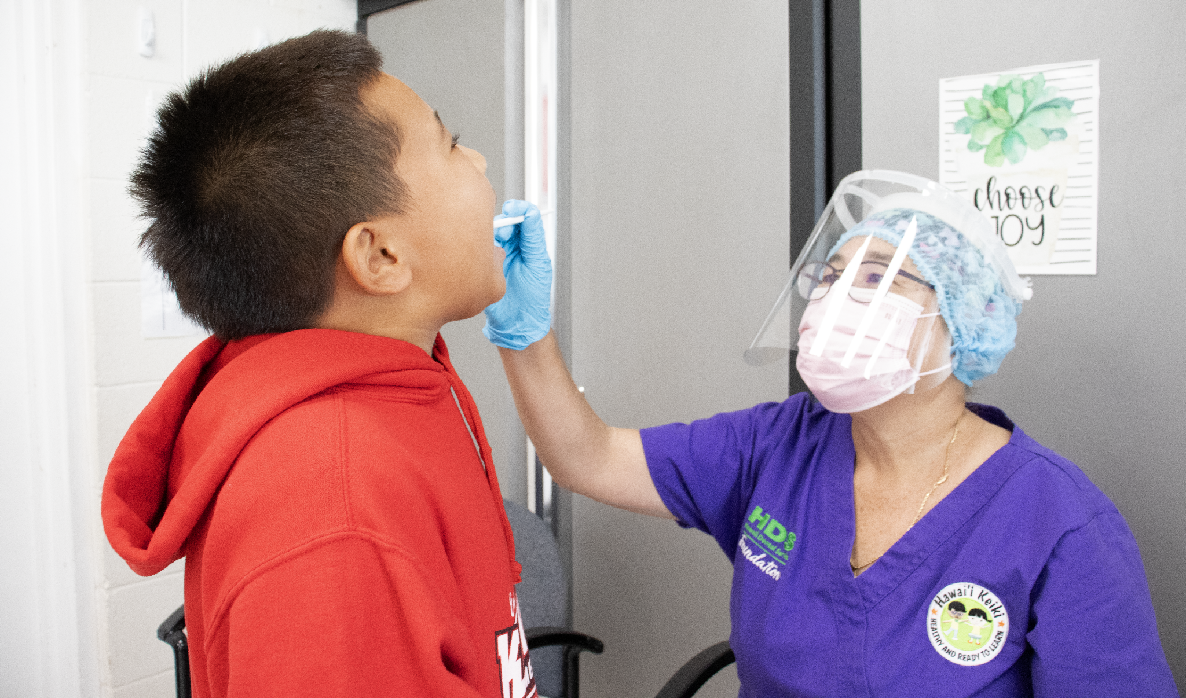
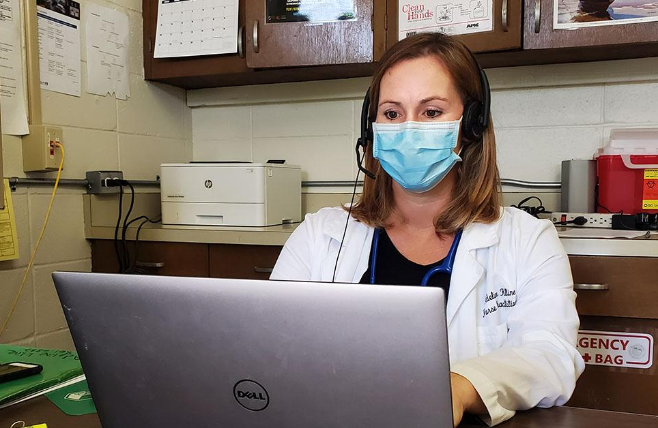
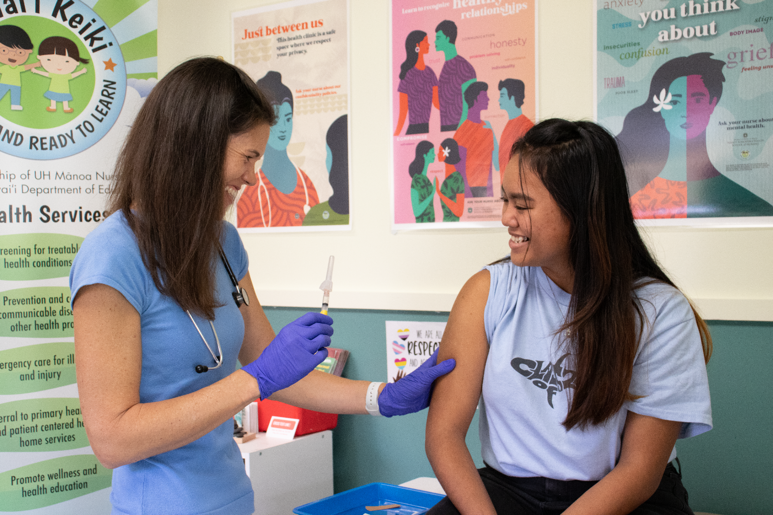
School-Based Health Services
School Nursing
Virtual Keiki Care
Mental Health Services
Nurse Practitioners (APRN) & Registered Nurses (RNs) serve schools within a complex area or charter school
Telehealth visits with Nurse Practitioner, facilitated with RNs or Health Techs (HT)
Virtual apts. with Psychiatric Mental Health Nurse Practitioner
Dental Services
Health Hotline
Vaccines for Children
Screenings and sealants for 2nd & 3rd grade students with a focus on Title I schools
Monday through Friday
from 8 a.m. to 3 p.m.,
excluding holidays & breaks
Routine immunizations for students in KKP & AMR Complex Area
Notes:
These six services are the ones that surrounded the heart in the earlier framework. These are the additional services that HK can provide to schools.

Slide 6
Hawai’i Keiki Asthma Education Efforts
All Hawaii Keiki staff completes Asthma Basics training by the American Lung Association within 30 days of being hired.
This year we launched our school year with a training from the EPA for all the health techs on clean air and asthma.
Other training our staff has implemented in schools:
Open Airways For Schools Facilitator Open Airways For Schools facilitators are trained to help children learn to manage their asthma. The training includes basic information about asthma, modeling of appropriate skills, a thorough review of the curriculum and tips for working with children.
INDEPTH Facilitator INDEPTH facilitators plan and implement an educational program for students as an alternative to suspension for violation of school tobacco, vaping, or nicotine use policies.
N-O-T Facilitator Not On Tobacco® (N-O-T) facilitators lead the American Lung Association’s proven teen smoking and vaping cessation program.
Notes:
The presentation by the EPA was a 2 hour training session for our health tech’s and school health aides and helped to dispel common myths around asthma, discuss the role of schools in prevention and give the staff tools to use to talk to students and parents about clean air and asthma.
As part of this training HT’s and SHA’s are working with schools to implement their air quality flag program, distribute coloring books about asthma and also helping schools with evaluating their environments and helping to mitigate triggers that can contribute to asthma flares. For example- understanding the role dust and cleaning products may plain in triggering symptoms. Helping staff understand the need of students to recognize when the grass is being cut or it is an especially hot day and they may need to take their preventative measures before PE.

Slide 7
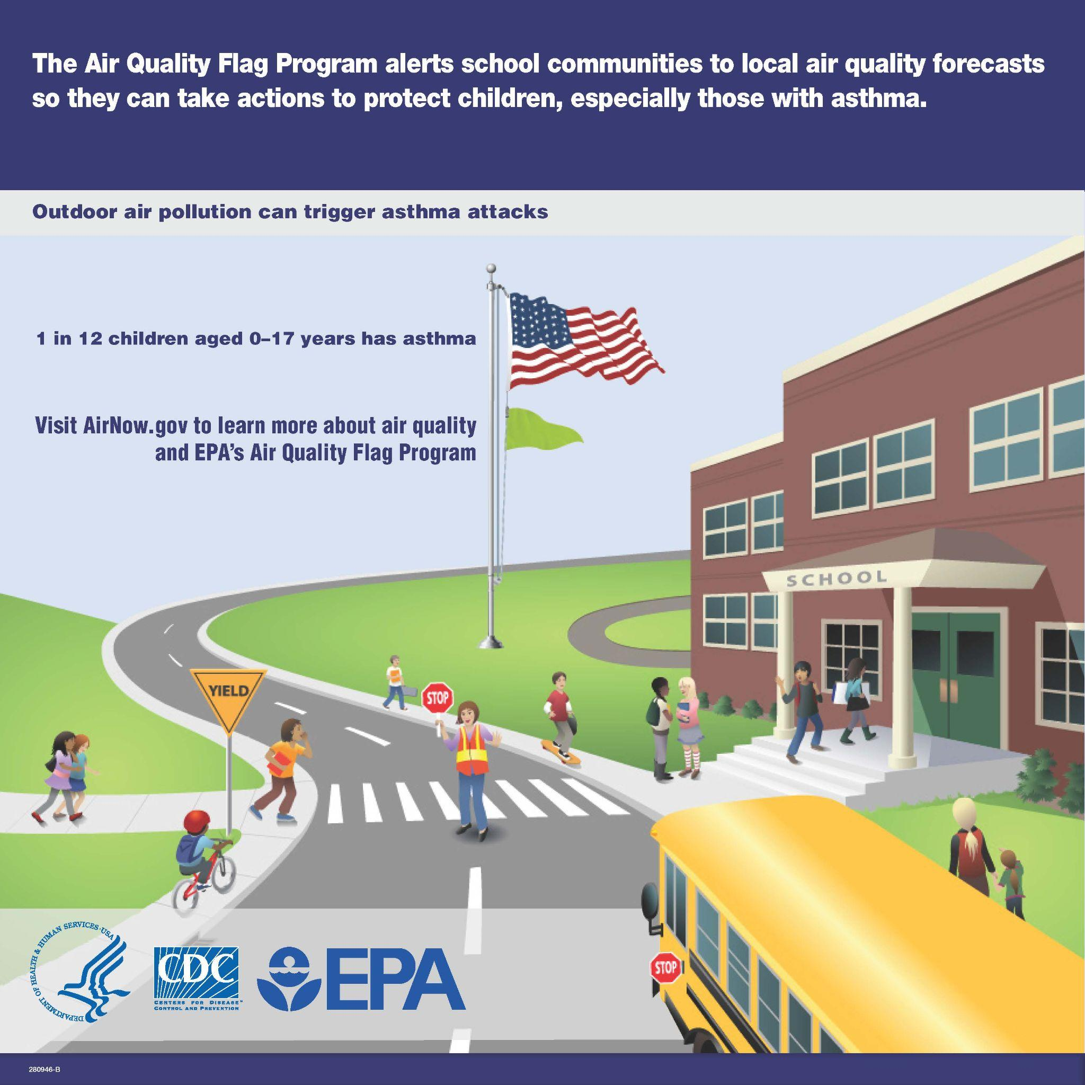
Notes:
Courtney to talk about the flag program at Nānāikapono Elementary School

Slide 8
Direct Education
Work with school staff, students, their parents and guardians and Public Health Nurses (PHN) on development of emergency action plans (EAP’s).
Provide teaching to school staff and students on asthma.
Provide direct care for our asthmatic patients.
Notes:
Courtney- here is where I may have you help me discuss the role of teaching and treatment at schools.

Slide 9
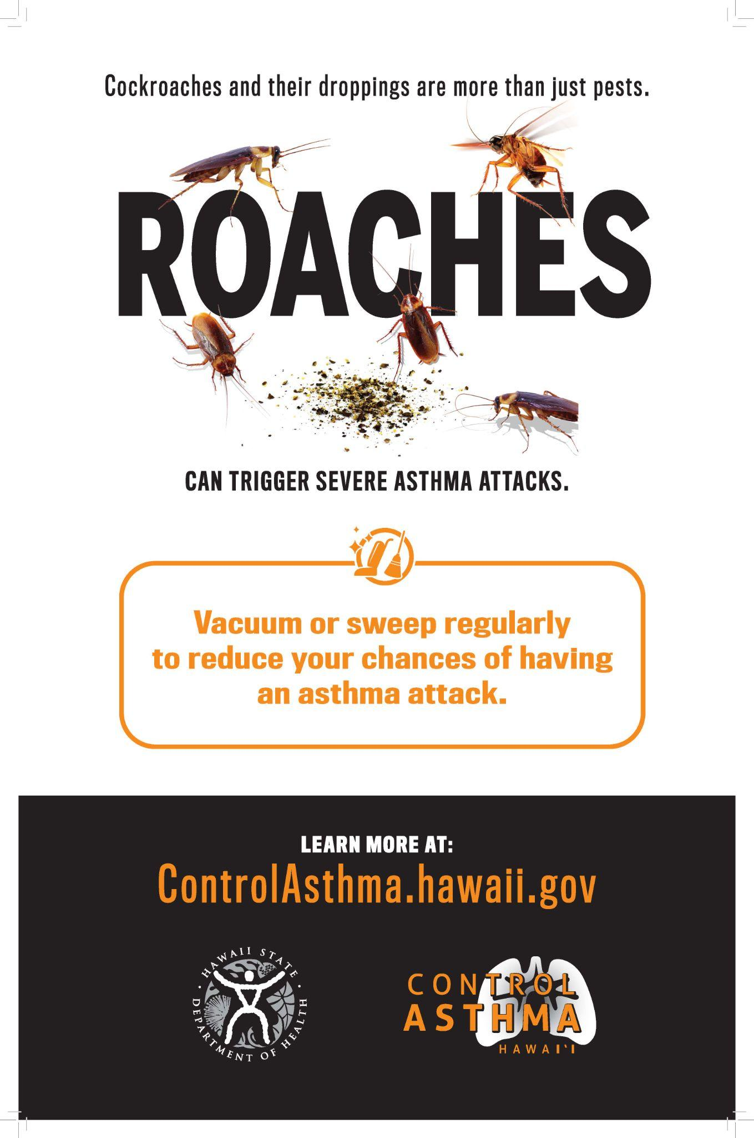
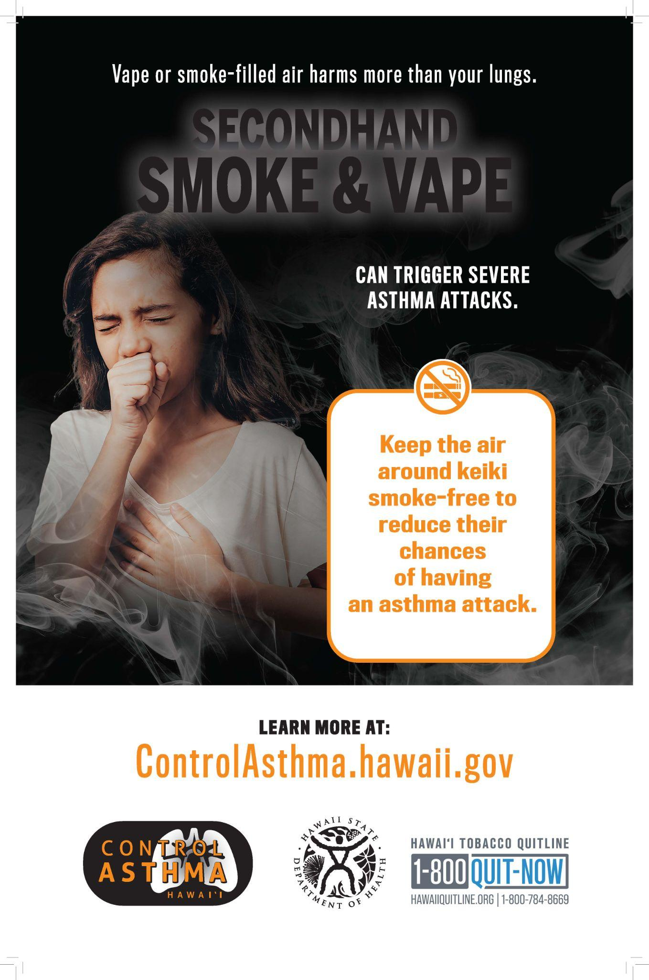
Control Asthma Campaign 2023
Hawaii Keiki partnered with the DOH to promote the Spring Control Asthma Campaign.
It ran from March to June, and included radio and televised interviews, digital, print and social media advertisements statewide directing public to the resource rich website.
Notes:
You may have seen some of the posters when out and about at Pearlridge or Ala Moana. They were designed to catch your attention!
Jordan from DOH and myself did multiple on air and recorded radio interviews as well as a televised spot to discuss the importance of asthma awareness, proper diagnosis and management.

Slide 10
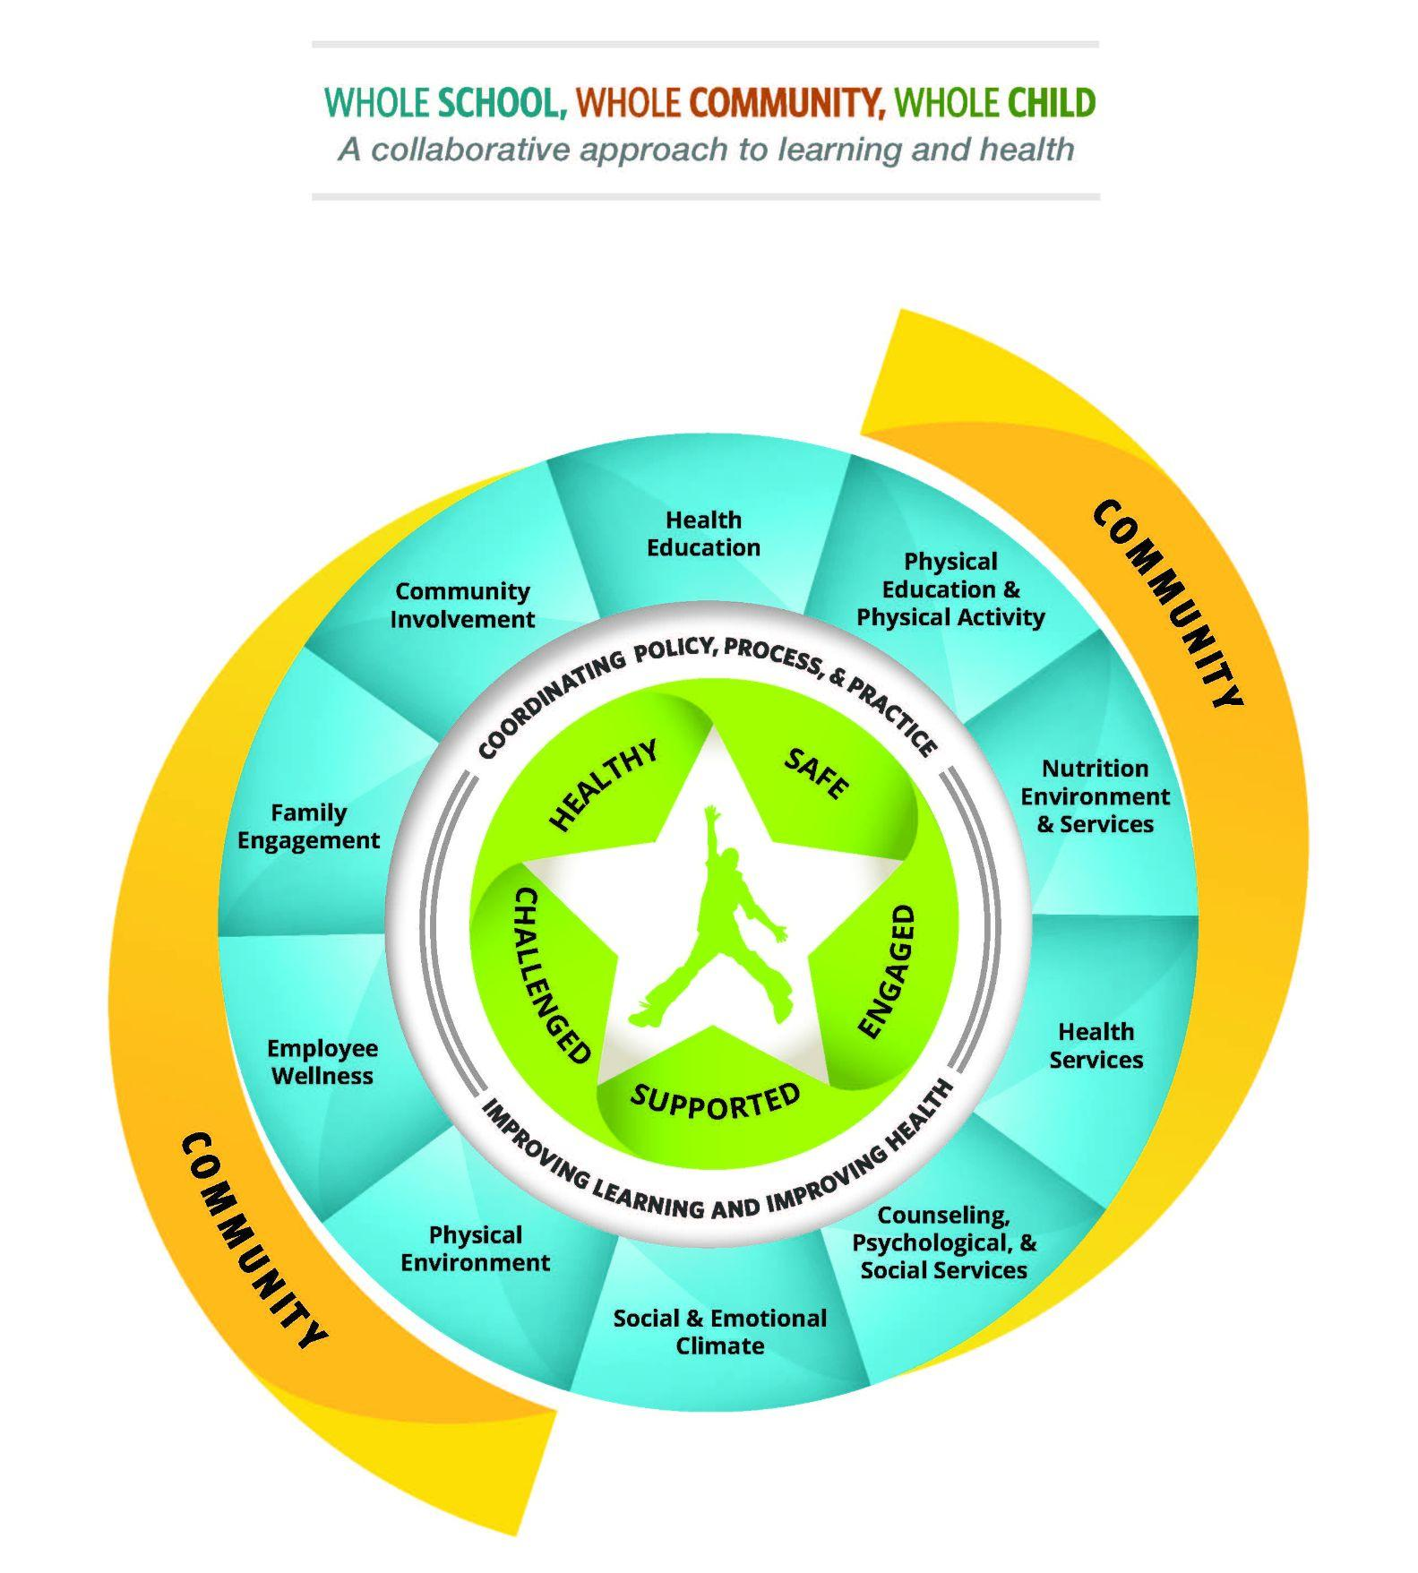
Education
Community Design and Access
Worksite
Health Care
https://www.cdc.gov/healthyyouth/wscc/model.htm
Notes:
Our program is based on the whole child whole community child model. As you can see our efforts around asthma overlap some of the goals of the HHSP 2030 in areas outside education- however in the interest of time I will just be briefly discussing how our efforts have meet the goals of the education sector objectives.

Slide 11
Healthy Hawai’i Strategic Plan
Education Sector Objectives: Asthma
Increase by 10% the number of sites implementing CDC-recommended school and/or community based Asthma Self Managed Education programs.
Expand the number of Asthma Self-Management Education (ASME) programs by facilitating partnerships with school- and community-based organizations.
Promote ASME programs with the new and existing partners.
Increase by 10% the number of sites implementing CDC-recommended school and/or community based Asthma Self Managed Education (ASME).
Expand the number of ASME programs by connecting potential volunteers.
Promote volunteer opportunity with new and existing partners.
Source: https://hhsp.hawaii.gov/objectives/sector/2

Slide 12
Barriers
Competing demands on time
Equity of access
Staffing
Interest and buy in from
Schools and community
Notes:
As we all know time is one of the most valuable assets we have and there is never enough of it. Our staff are based in one school but cover multiple schools within a complex. There are many competing priorities in caring for acute illness, managing children with complex medical and social concerns and educating and supporting those who need it.
Not every school has an HK staff member or asthma champion.
The priority of schools is education, which means all the other conflicting priorities come secondary. The pandemic increased the public's awareness about the importance of health conditions and how much they impact us outside of traditional healthcare.
Our statewide school system is very diverse, not just in the population that attends the schools but also their locations and challenges. For example the barrier in Honolulu may be on days like last week when the trades die and we have an urban layer of pollution causing asthmatics to have unsafe air. On our neighbor islands it may be the access to primary care and specialists to help accurately treat and manage symptoms.

Slide 13
Looking forward: Next Steps
Scale up trained and comfort of HK staff to deliver CDC approved curriculum to schools.
Partner with health academy students to engage the next generation in awareness and activism around asthma.
Continue to provide high quality evidence based care to our students and staff.
Partner with local pediatricians, FQHC’s and PHN’s to wrap around care and improve asthma management in schools.

Slide 14
Resources
American Lung Association- Asthma Basics
CDC Schools and Asthma Control
Hawai'i Keiki Website
Healthy Hawaii Strategic Plan

